Slide 1
Revit Material Libraries
ORB University

Slide 2
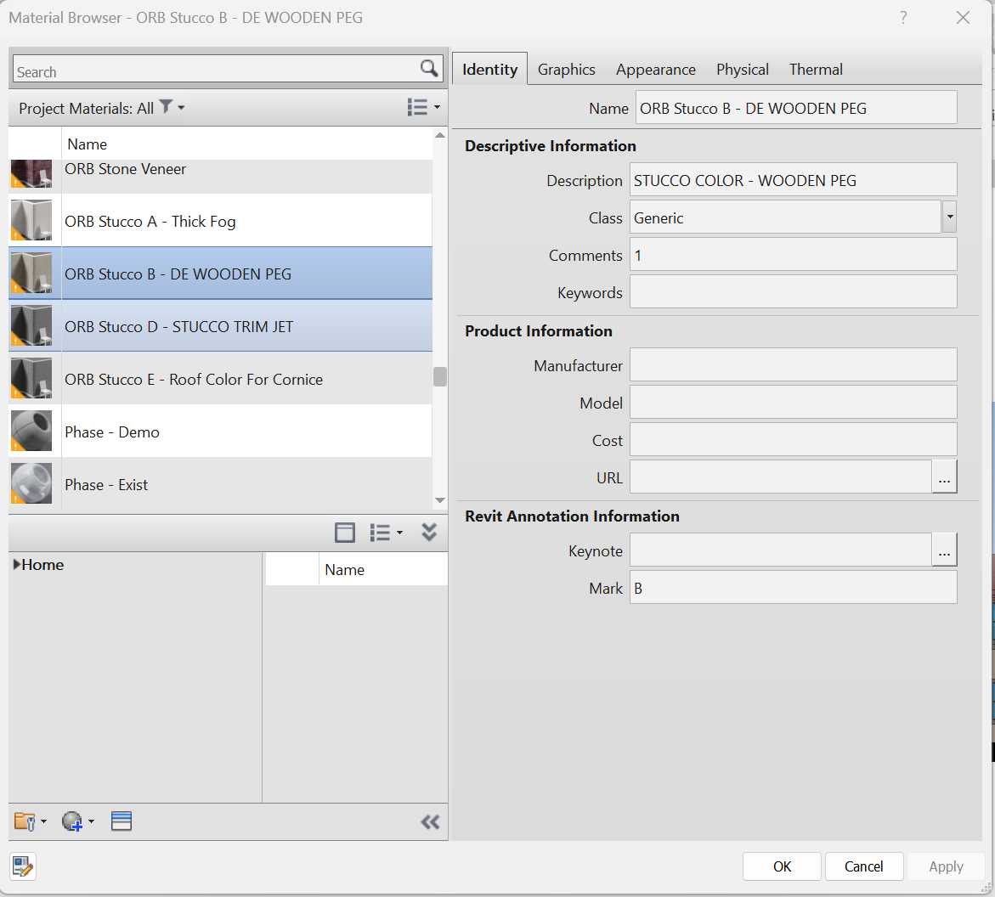
Revit Materials – things to know

Slide 3
Revit Materials – things to know
Identity tab controls the data/ information specific to the material being used
Name will be important when we get to the material library – we will discuss more in a bit about this.
Description is the information/ text that will be located in the material legend of the elevation sheets. If this does not match for every single material – the material legend will not filter and sort correctly.
Mark is the letter designation that shows up in the material legend on elevation sheets, as well as the mark that occurs in the material tag bubble

Slide 4
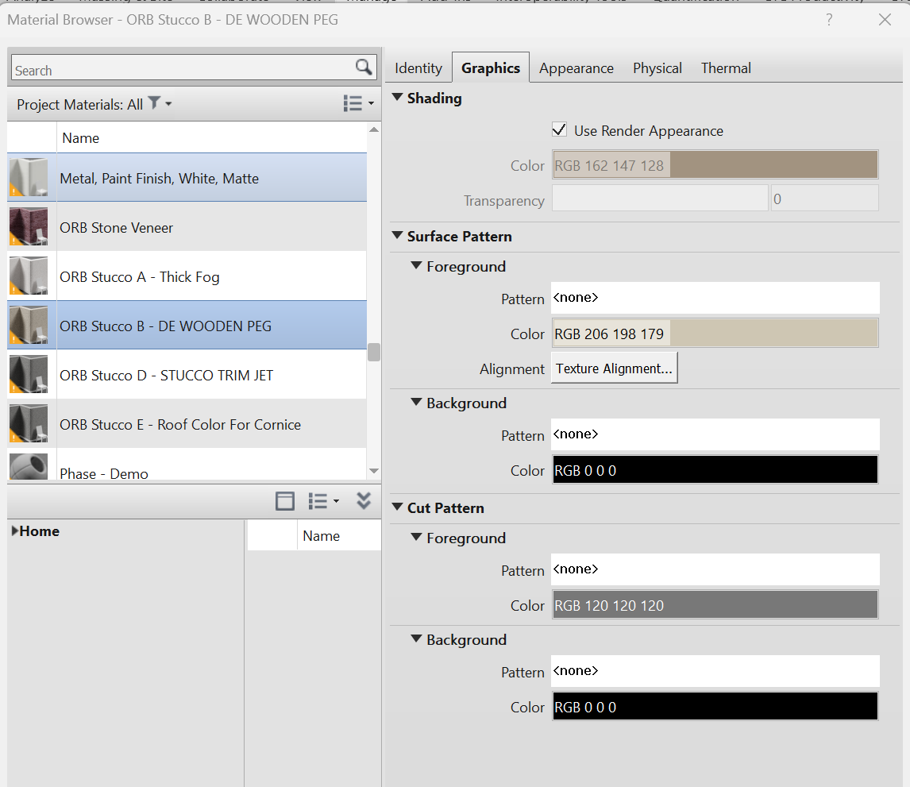
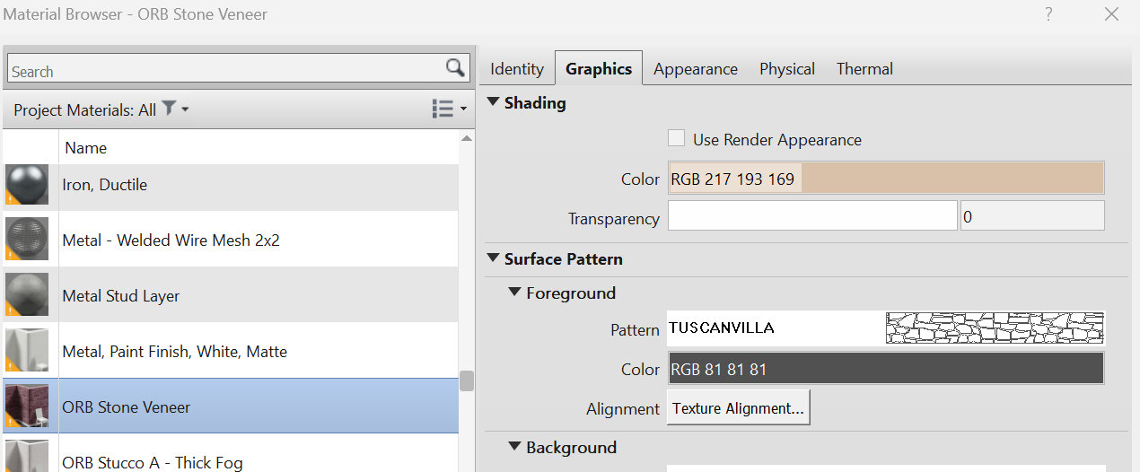
Revit Materials – things to know
Graphics tab controls what the material looks like in the non-rendered Model Display settings like “Shaded” and “Consistent Colors”
Only use this option if you’re using a photo, bump etc. on the Appearance tab and want it to match
Paint color – RGB values can be found on most paint manufacturer’s websites or if using some kind of veneer material, try to match the color here
Can add stone, brick or even stipple texture to make exterior elevations read clearer

Slide 5
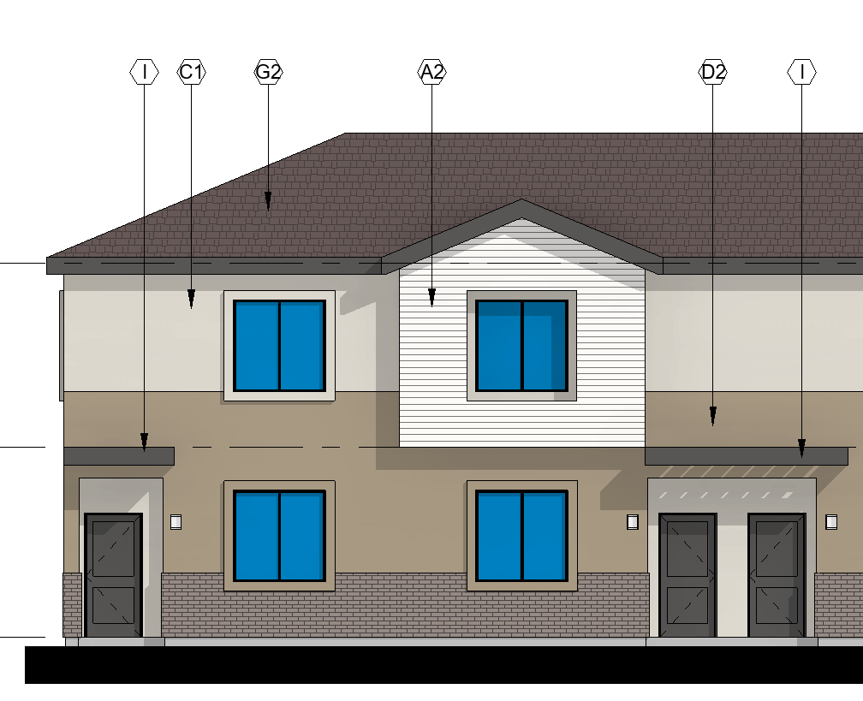
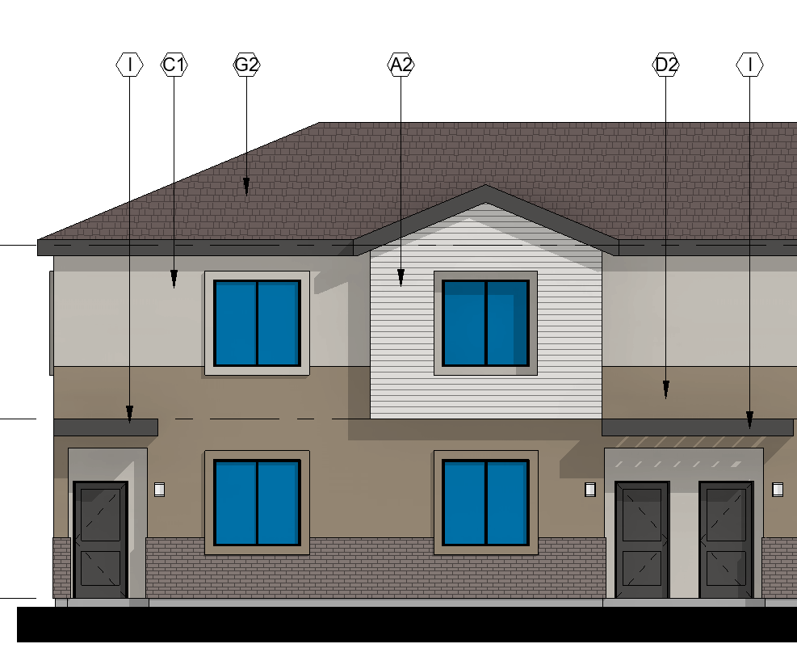
Revit Materials – things to know
Consistent Colors
Best for 2D, flat views like colored building elevations
Shaded
Best for 3D views where material is affected by shade, lighting location etc.

Slide 6
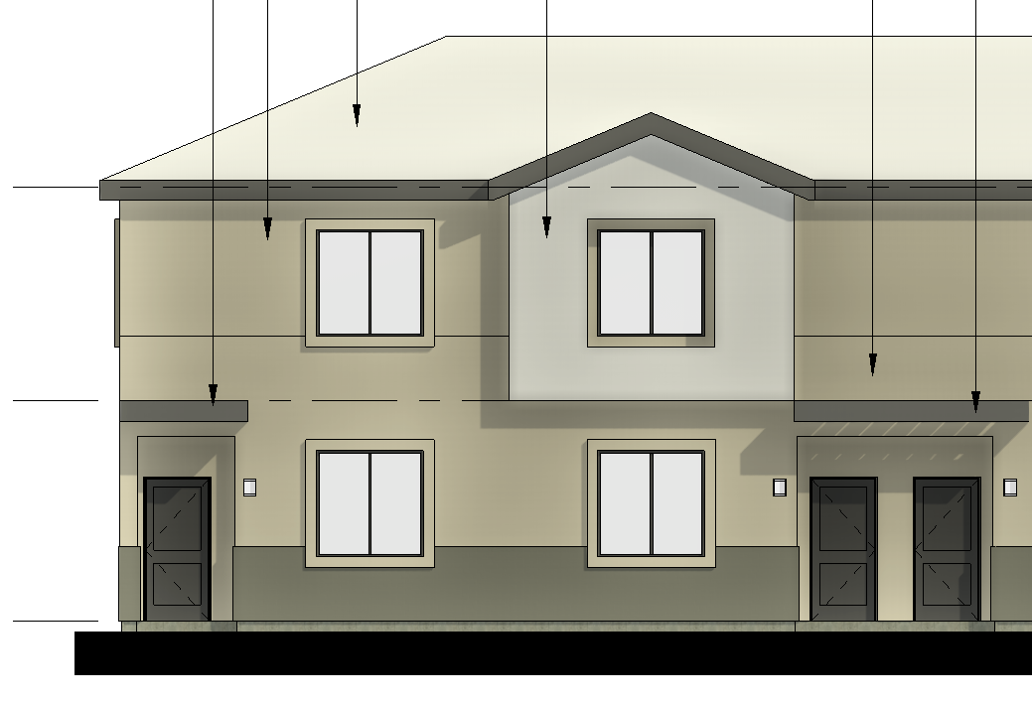
Revit Materials – things to know
Shaded
Consistent Colors
If you are using the model for rendering purposes, make sure you also update the “Appearance” tab so you don’t end up with this…
Realistic – not adjusted to match Graphics

Slide 7
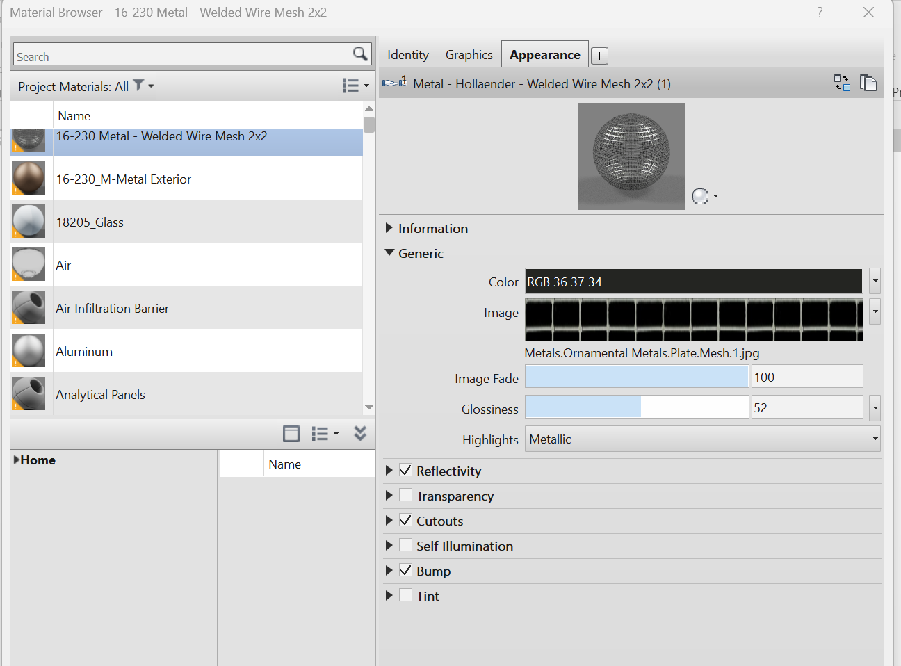
Revit Materials – things to know
Appearance tab controls what the material looks like in a 3D rendered condition or on the “Realistic” model display. This could look completely different than the graphics, so if you are using the model for rendering purposes, it is important to adjust these settings to match your material as closely as possible
If you have stone, roofing, metal or other materials that will be used for rendering quality work you can add the image here as a tile to create the rendered surface
Cutouts and Bump files are also images that can be used to help create your rendered appearance. Cutouts would be used for something like a mesh, a breeze block etc. and Revit reads the black part of the image as the “cutout” and treats it like a transparent void in your rendering.
Bumps are the same image as your material however in a high contrast black & white version that creates a texture for your rendered view

Slide 8
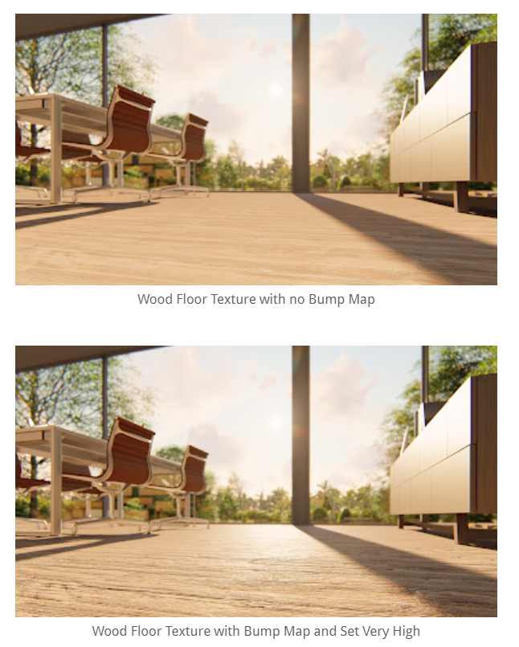
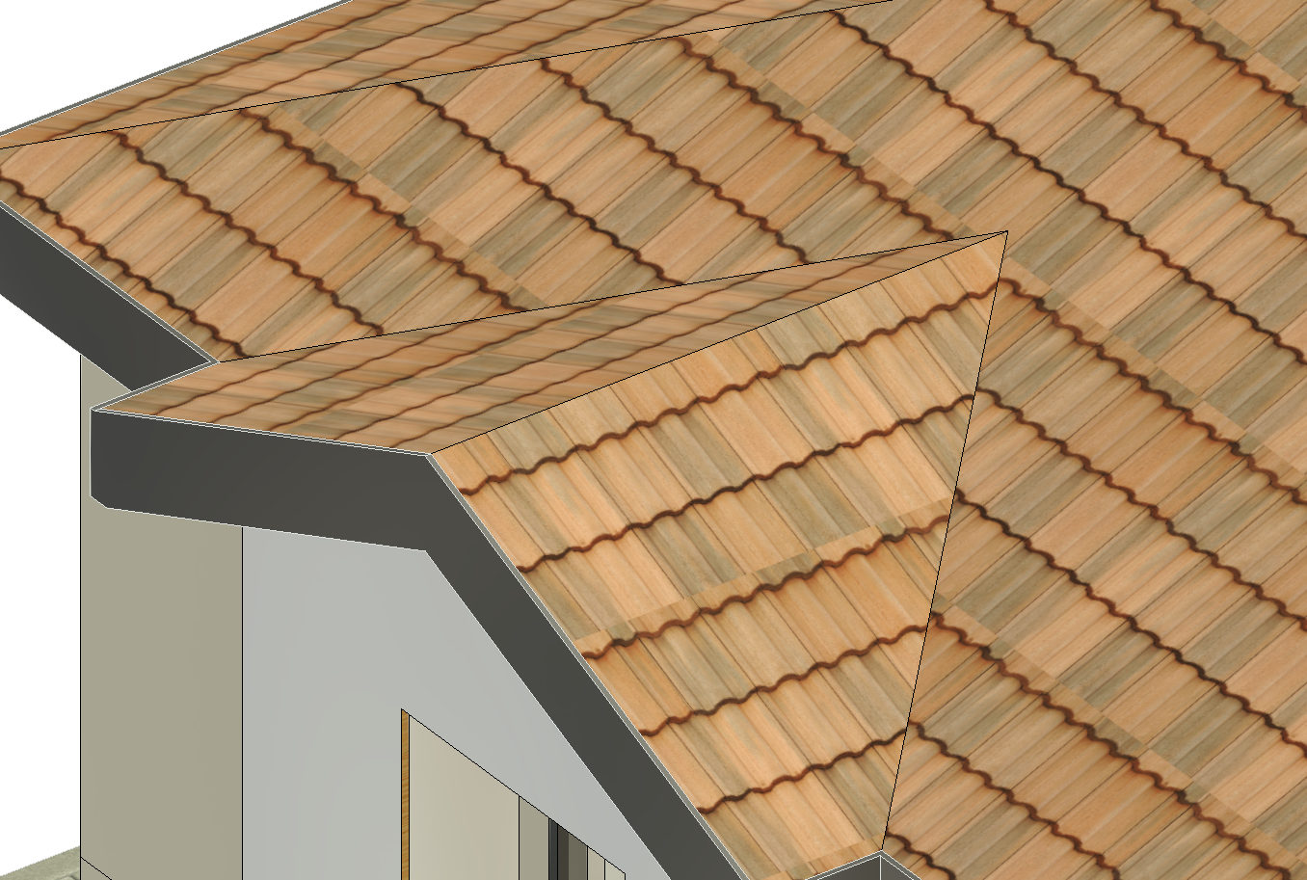
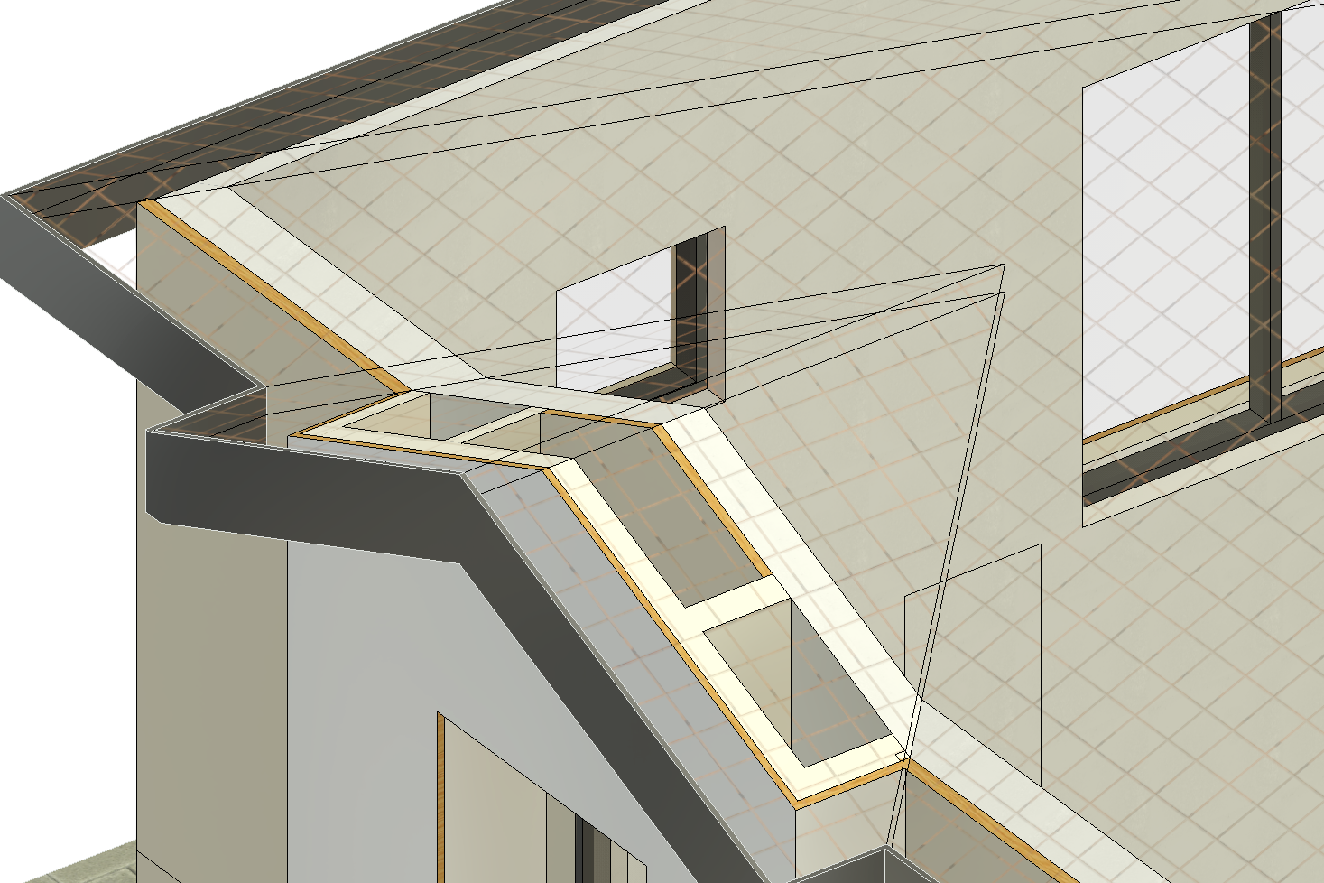
Revit Materials – things to know
Image from “The Revit Kid Blog”
Generic “Realistic” view with basic material appearance settings
“Realistic” view with roof material and wire mesh cutouts

Slide 9
Revit Materials – best practice
Purge materials that are not used in the project (do this often). Even if a material gets deleted, you can always bring it back later especially if it’s in your material library.
Don’t copy elements from other projects, that will bring in materials not specific to your project
There is an ORB Material Library for exterior finishes that can work as a starting point. Do a “Save as” of the material library into your project folder under the BIM folder, next to the keynotes and checklist documents. Remember to include the project number in the name of your material library

Slide 10
Now – on to Material Libraries!
Who
What
Material libraries are especially useful on projects where you have multiple building types across one site, such as townhome style, build to rent and garden style projects
Where
Material palettes that require several different paint colors, schemes or alternates
Locate material libraries in the BIM project folder, next to the project keynotes and checklists
When
Why
Material libraries benefit the project the most if they are coordinated early on, such as in a schematic or entitlement phase when exterior elevations are started
As the design development progresses, changes to materials from the City, neighbors or Owners can be applied very quickly across models using material libraries and helps keep consistency for tagging materials and graphics, while shortening the amount of time being used for repetitive tasks

Slide 11
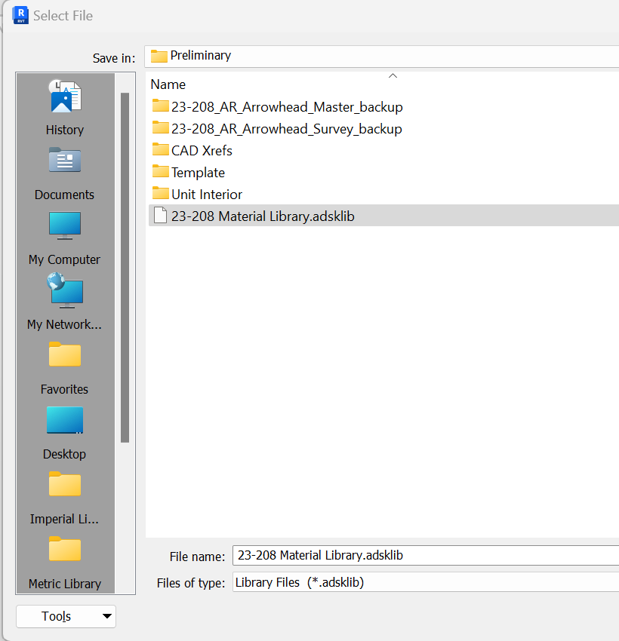
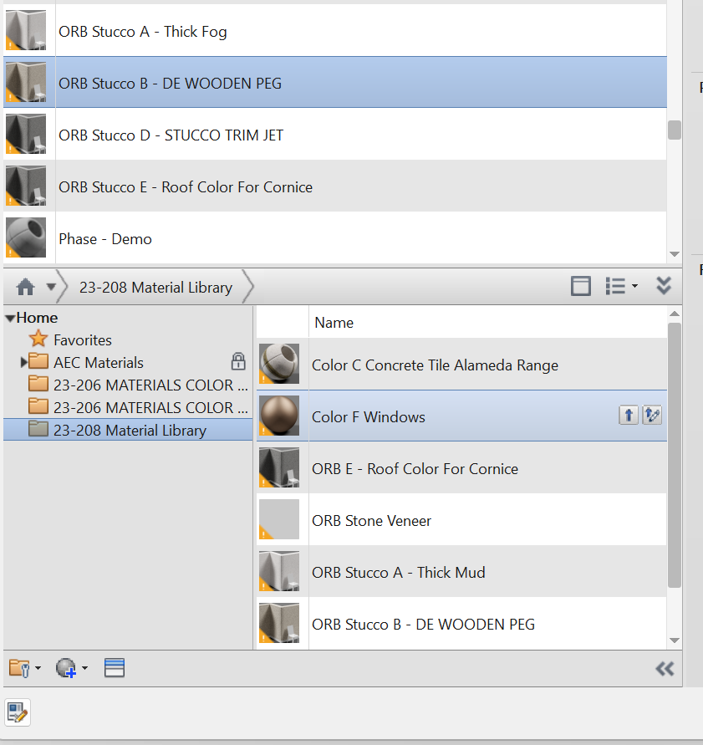
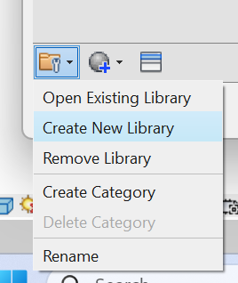
Creating a Material Library

Slide 12
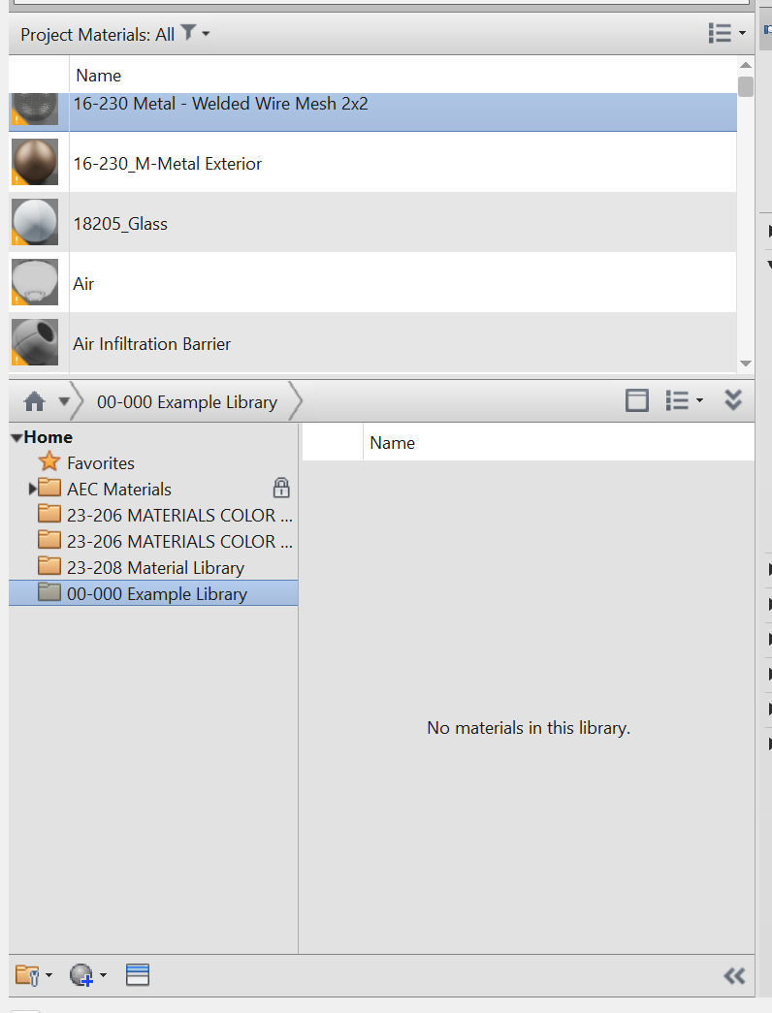
Creating a Material Library
BEFORE YOU START DRAGGING MATERIALS INTO THE MATERIAL LIBRARY!
The information brought into the material library will carry across all other models used with the library.
Do not drag materials into the library until you’ve set up the correct material name, description and mark to avoid having to re-do work.
Also, before dragging materials in, create any categories needed, for example if you have multiple color schemes for a site
???

Slide 13
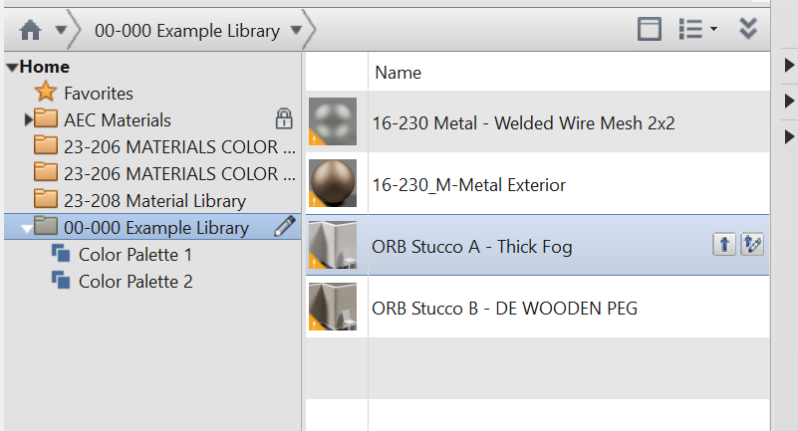
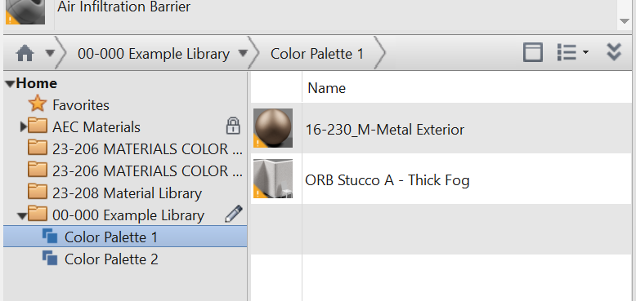
Adding Materials
To add materials to your library, drag into the Library palette
Updates to the material library will save automatically when you sync your model after any changes have been made.
If you have separate materials – for example Color Palette 1 and Color Palette 2 for the same building, you can separate materials by category

Slide 14
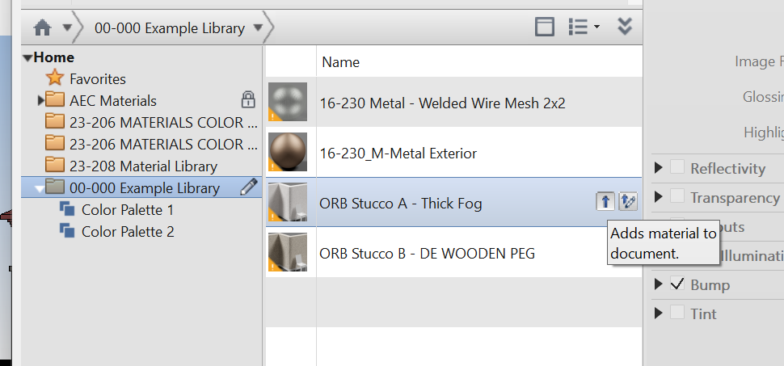
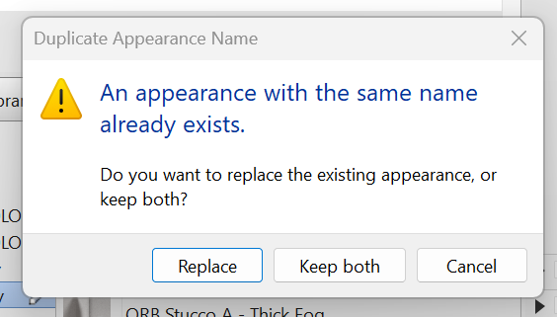
Bringing Materials into a Model
Adds the material from the Library into the material palette of the model. You can also drag the material up into the palette.
If a material of the same NAME already exists, Revit will ask if you want to “Replace” or “Keep Both”
If you “Replace” the material in your model, it will get overwritten with any new identity information, RGB values or appearance selections and images to match what is in your Material Library
If you “Keep Both” the material from the Library will get added to the model with “(1)” or something similar appended to the end.

Slide 15
Replacing or Updating Materials – Important information
Revit uses the NAME of the material to overwrite or replace material assets
If you know that you will have multiple stucco colors, multiple color schemes or that the material paint colors, stone/brick/CMU styles will be changing – I would highly recommend using generic naming for your materials
Instead of referencing a specific color such as “ORB Stucco B – DE WOODEN PEG” consider using “ORB Stucco B – Medium Stucco” (light stucco, stucco accent etc.)
When you go to replace a material across all your building models, it will automatically update without having to rename multiple materials in the model. When you change the name, you have to go into the model elements and update all walls, pop-outs, window frames, door frames etc. to the newest material
Now – if you already have a material library with specific color names in it, there is a work around…

Slide 16
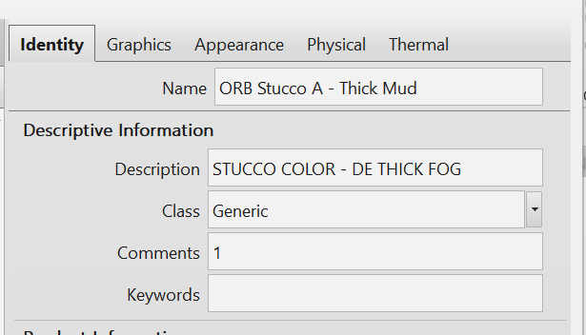
Updating Materials – Work Around
Light Stucco
If you have already set up materials with specific names…
Two ways to approach this – you can change the name of the material from a specific color/ brand name to generic and do this across all the different building models. You will only have to do this once and will have to ensure that the name is identical between all models AND the associated material library. A bit more work up front to get it to the correct name but over the course of the project, will help things go faster.
OR
If you want to maintain the color/ brand in the material name to help associate which color is which, then every time you make a color change or update, I would recommend changing the description, mark, RGB, Appearance data etc. one time WITHOUT changing the name of the material. Then, overwrite the material in each model BEFORE you go back and change the name of the material. This will ensure that all of the Identity, Graphics and Appearance data will match across all the buildings.

Slide 17
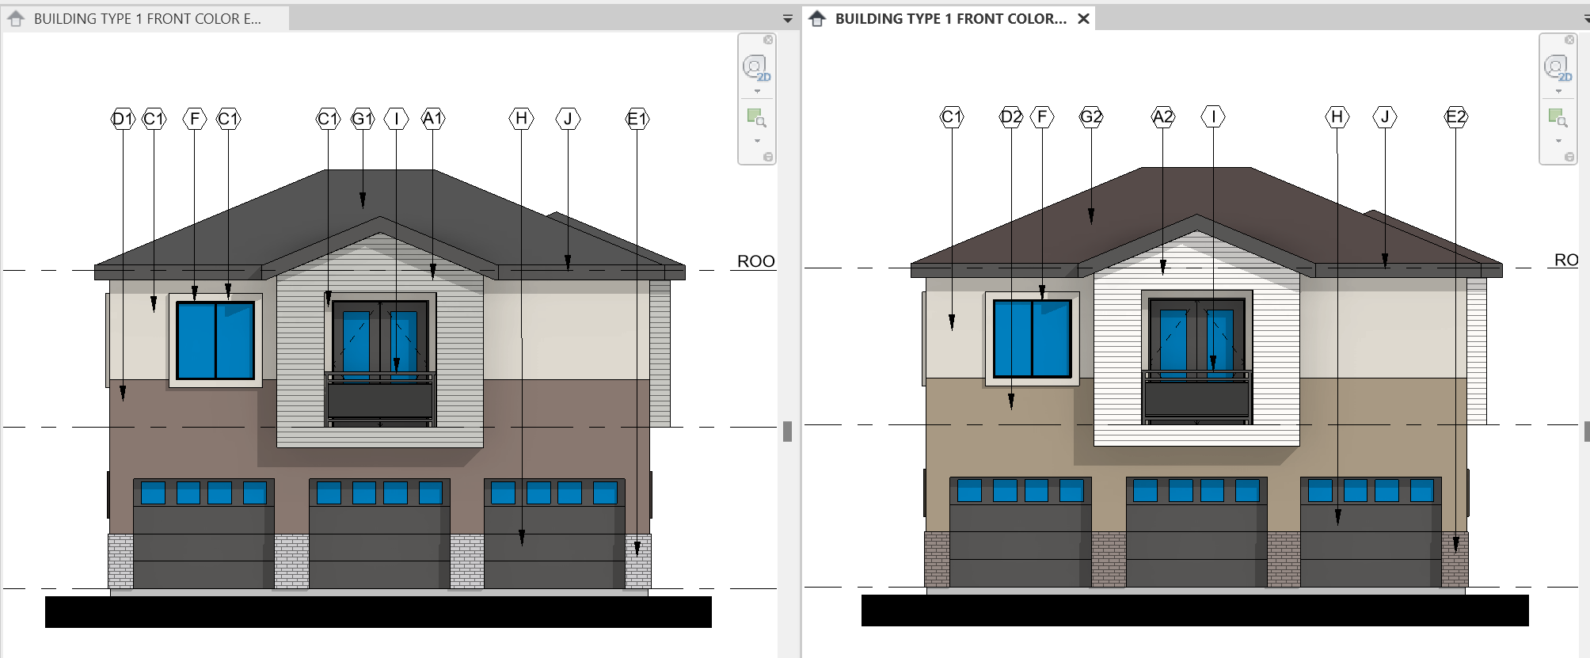
Practical Applications - Color Schemes
On sites with several of the same building type – jurisdictions may require two separate color schemes. This can be set up using Design Options. You will need to create two groups of walls and finishes associated with the color scheme and assign it to a Design Option.
COLOR SCHEME 1
COLOR SCHEME 2

Slide 18
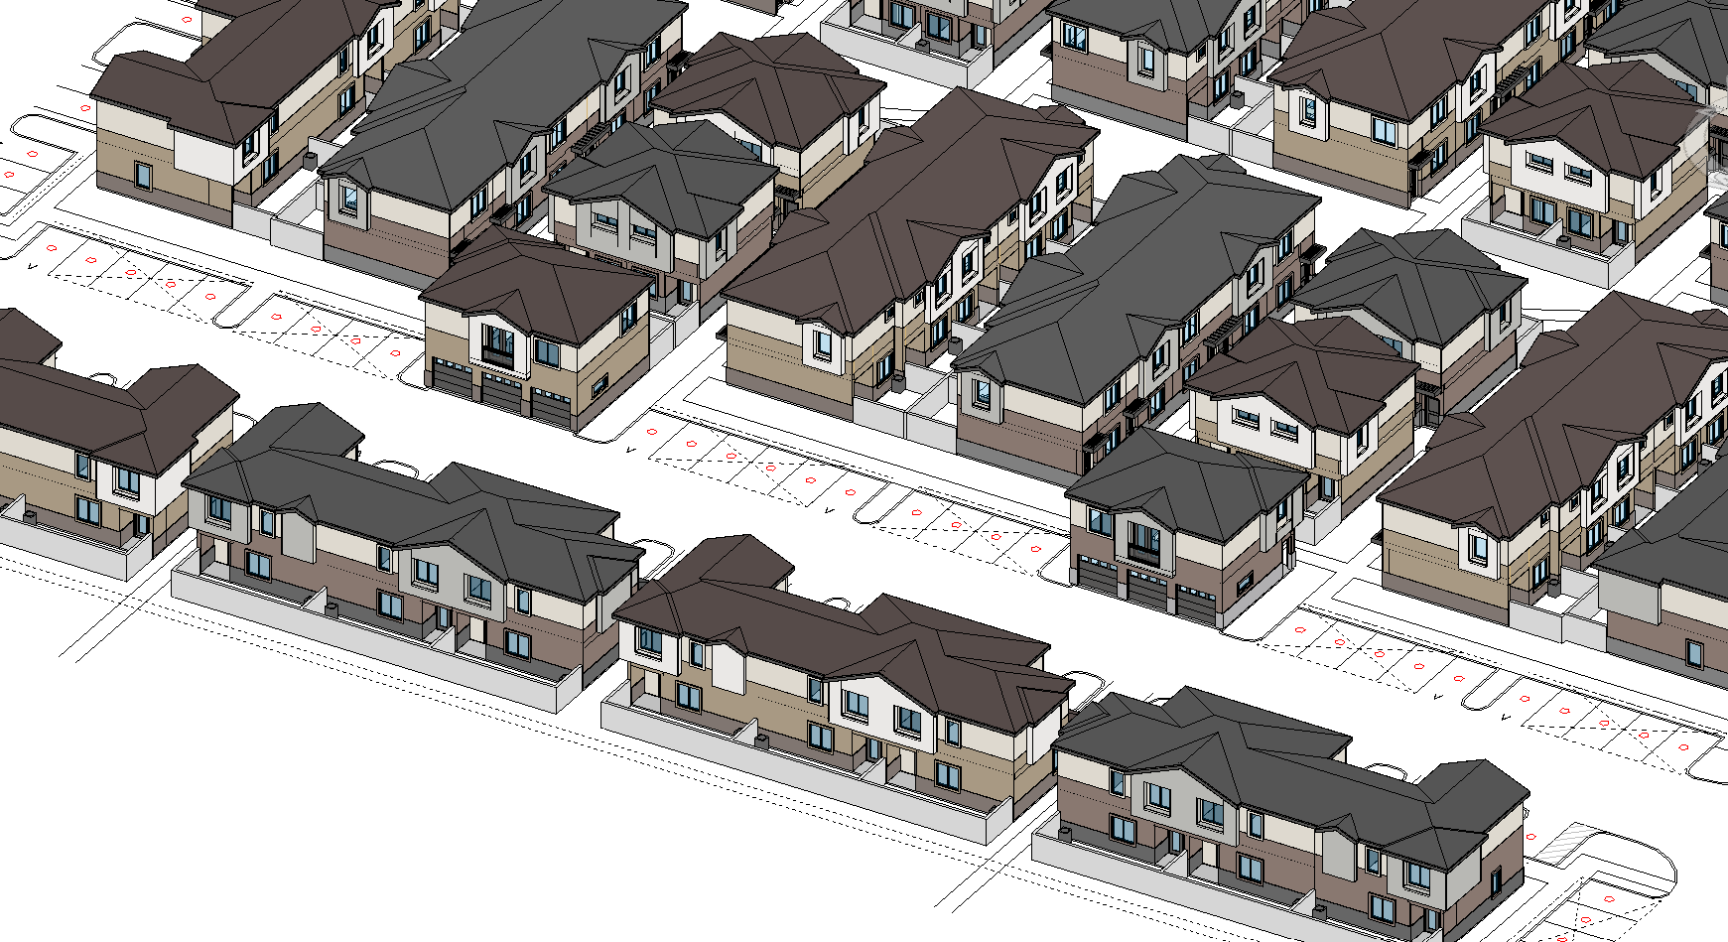
Practical Applications - Color Schemes continued
For the purposes of renderings or site views – you can also use Design Options on the overall site model to designate which color scheme occurs where on the site. .

